Slide 1
JC Lifecare
Mobile Reporting

Slide 2
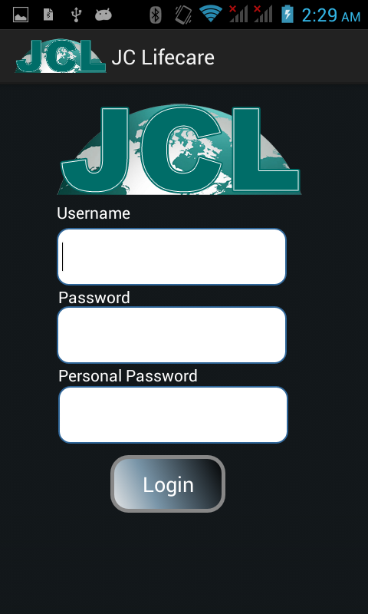
Login Screen
After installation of app first time login screen look like it. When start login first time then mobile must have internet connection.
Username: The username we use in HRM System that same username we here.
Password: The password we use in HRM System that same username we here.
Personal password: this password we take which memorable .

Slide 3
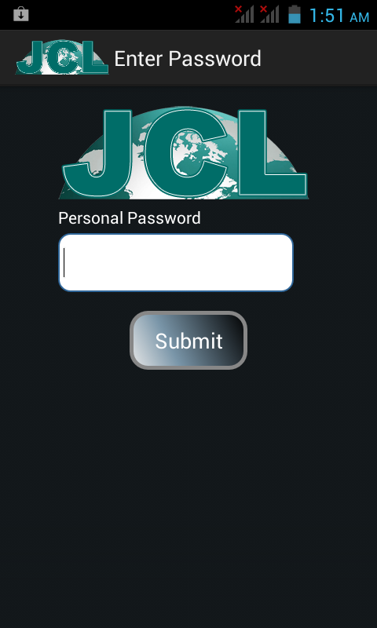
Personal Password Here User have to enter their personal password which they have chosen at the time of first login. This password required every time when we start the app.

Slide 4
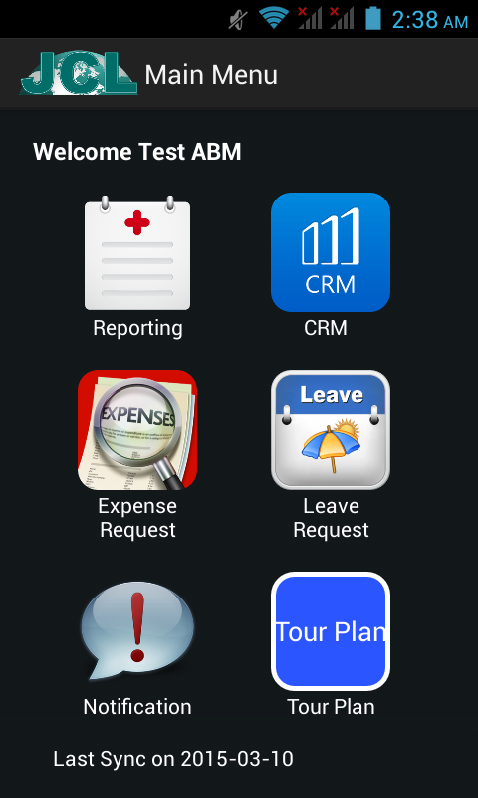
Main Menu
This is main screen of the app from where Employee can chose their working area.
Reporting
CRM
Expense Request
Leave Request
Notification
Tour Plan

Slide 5
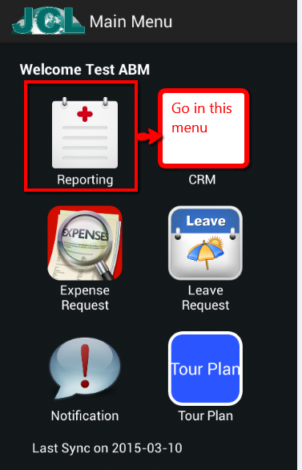
Go for Reporting
Here we can choose reporting menu to report of call activity like doctor , chemist and stockist call.

Slide 6
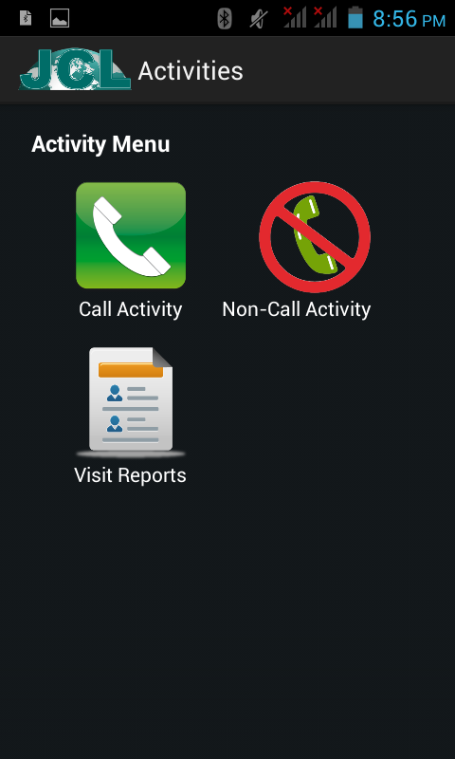
Reporting Menu
There are three submenu of Reporting
Call –Activity .
Non-Call Activity
Visit Reports

Slide 7
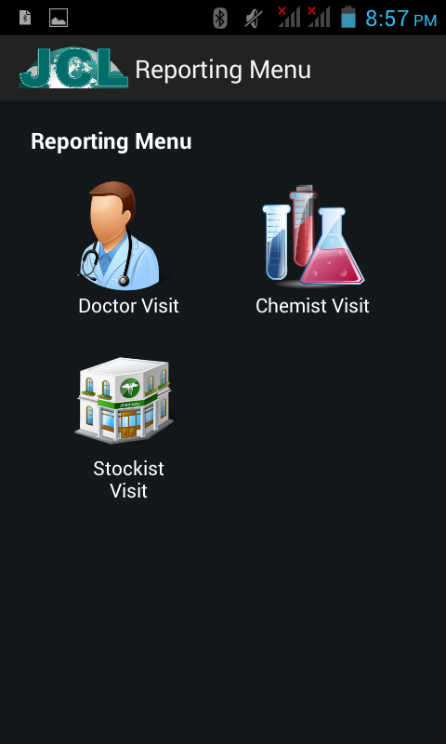
Call Activity Menu
Here are 3 different menu for call activity.
Doctor Visit
Chemist Visit
Stockist Visit

Slide 8
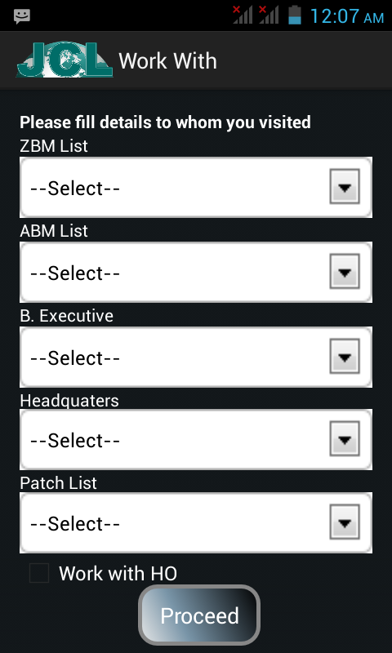
Visit Work With
When going for visit a Doctor , Chemist or stockist then whoever work with us.
This option applicable for all level of employees like BE,ABM,RBM and ZBM.
Also select patch in which they going to work.

Slide 9
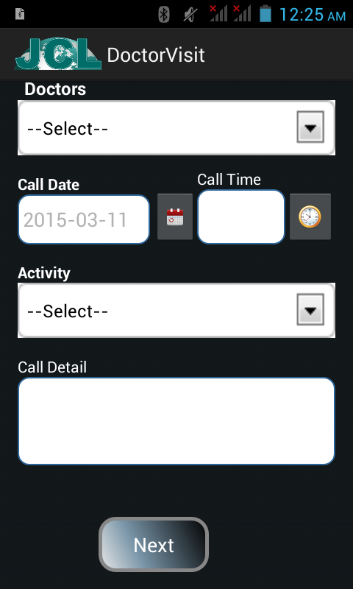
Doctor Visit
Select Doctor
Date and Time of Visit
Select type of doctor as activity.
Fill details about call at least 15 character.
Click next it will ask for a confirmation

Slide 10
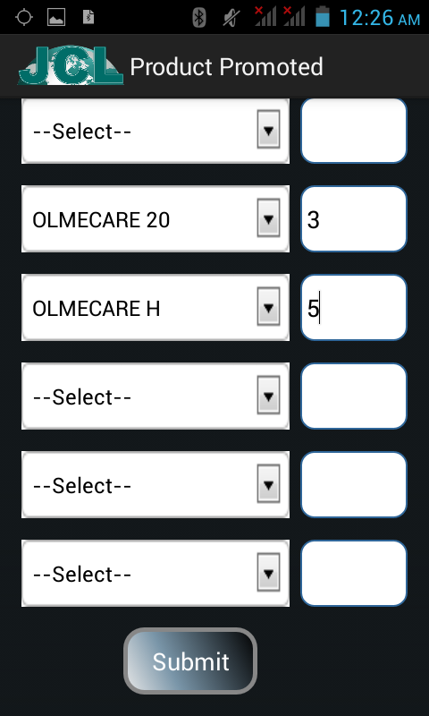
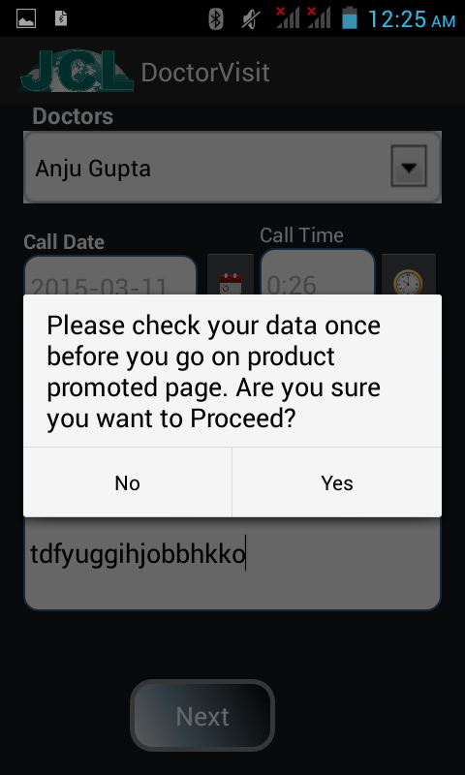
Product Promotion
When click Yes on confirmation page then next page will be Product Promotion where select product and fill unit if sample gives to doctor and submit report. It again ask for confirmation for check you data.

Slide 11
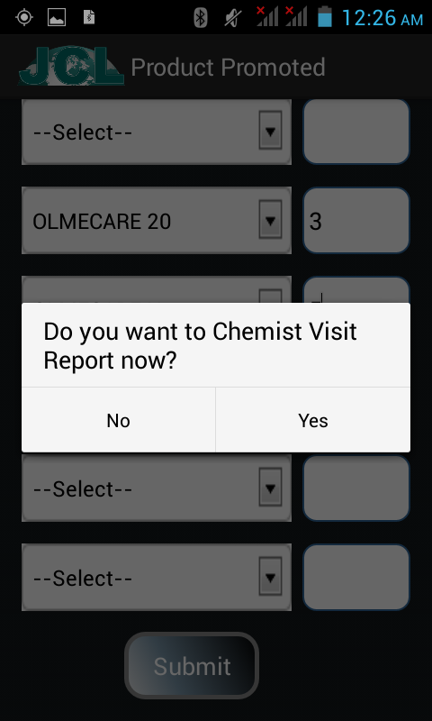
Go To Chemist Directly
When Doctor Report submitted then ask for chemist visit so we can go for chemist visit directly from here.
If we don’t want chemist report now then press NO.

Slide 12
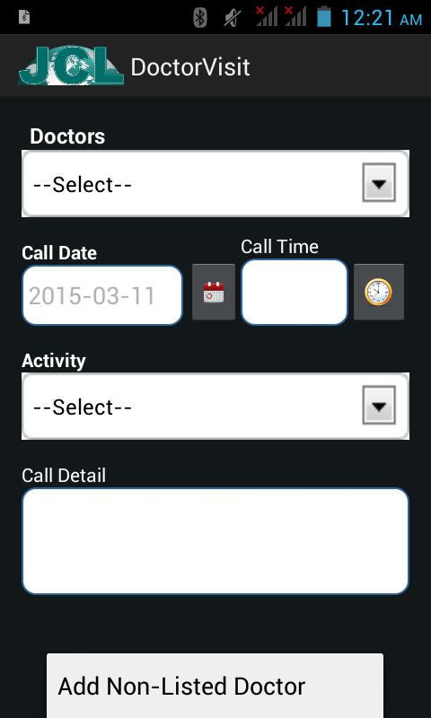
Non-Listed Doctor Option
When we looking for a doctor and that doctor is not in list then we can add a doctor from here
Go to menu option and click menu

Slide 13
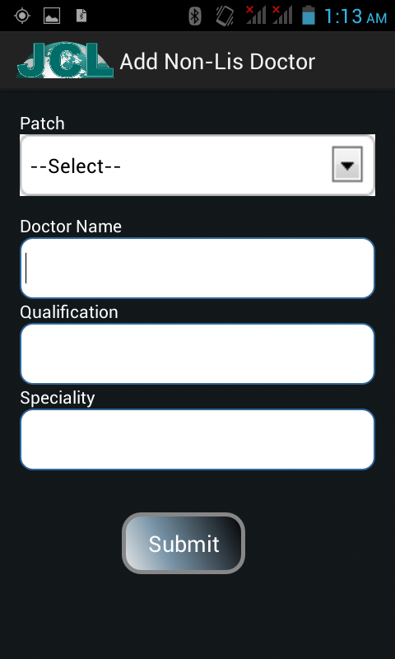
Add Non-Listed Doctor
When a doctor is not on list for which user wanted to report then they can add that doctor by these details.
After add doctor from here go to doctor visit and find this doctor on list it will be there.

Slide 14
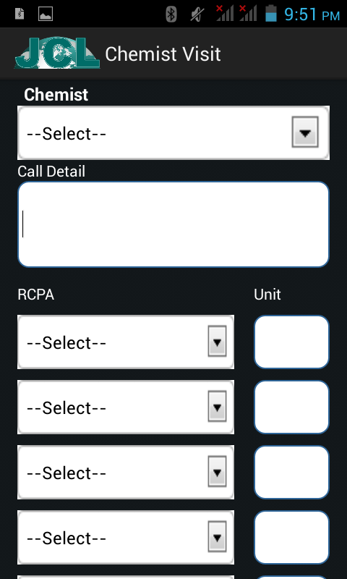
Chemist Visit
Select Chemist
Details about call.
Chose RCPA and unit(if any)
Submit the record then ask for confirmation, select Yes for confirm.

Slide 15
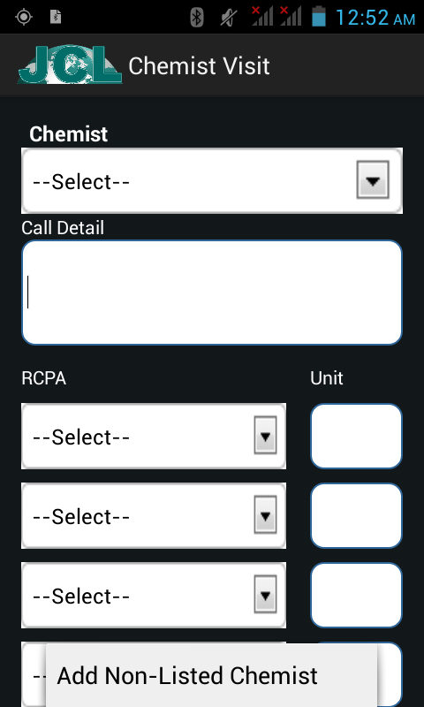
Non-Listed Chemist Option
When looking for chemist and that chemist is not in list then we can add chemist from here
Click Menu Option on Chemist visit screen

Slide 16
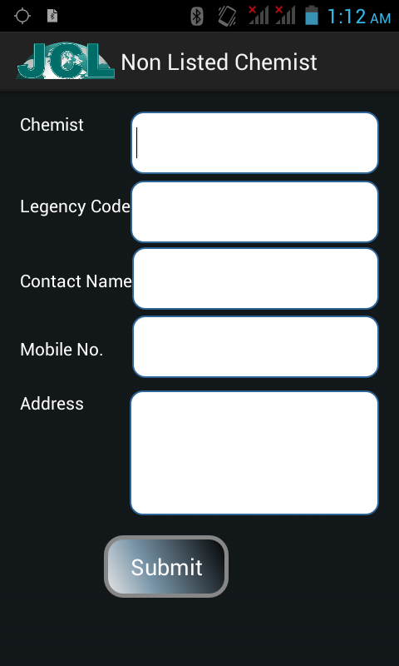
Add Non-listed Chemist
When a Chemist is not on list for which wanted to report then you can add that chemist here.
After add from here go to chemist visit and find this chemist on list it will be there.

Slide 17
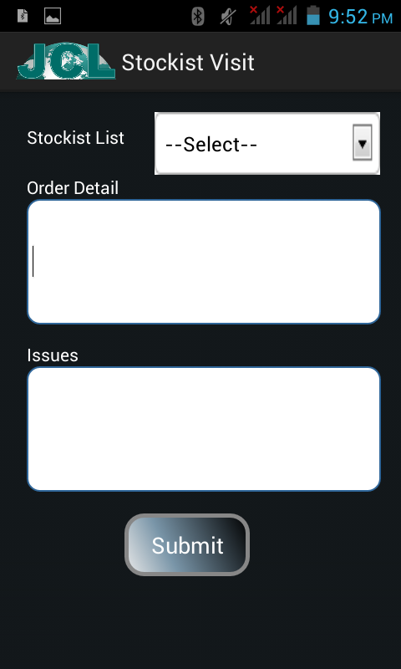
Stockist Visit
Select stockist
Fill Order details(if any)
Fill Issues of that stockist(if any)
Submit after fill details it will ask for confirmation and select Yes it will submitted.

Slide 18
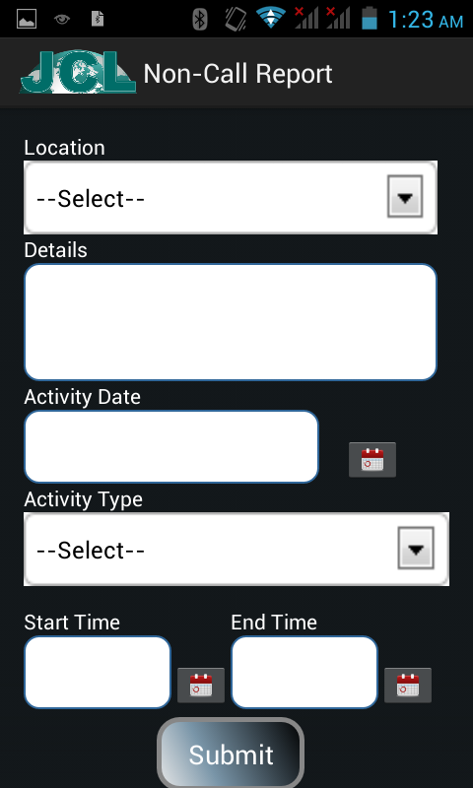
Non-Call Activity
When Employee will go for other work apart from Call Activity like
Meeting.
Seminar.
Medical Camp.

Slide 19
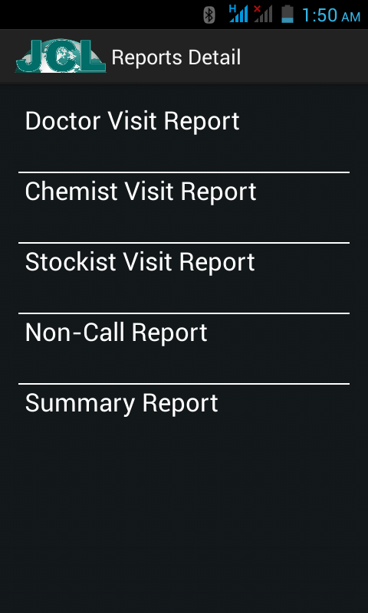
Visit Report Menu
All the reports that we have submitted from call activity or non-call activity for those reports summery we can see here. Reporting authority also can see their team report.
Chose the specific report type and see the summery report of current month.

Slide 20
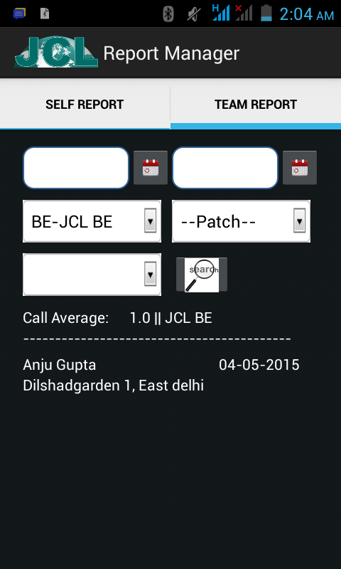
Team Report
This Tab only visible for Approval Authority like ABM,RBM and ZBM.
Here we can filter report by Employee, patch and doctor.
We can also filter with reporting date.

Slide 21
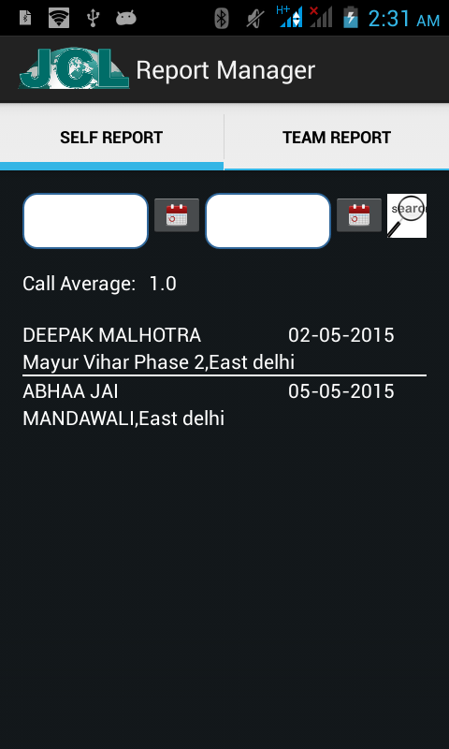
Self Report
The first Tab will show the summery of self visited report.
We can also filter on date.
Call average, Doctor name, Patch Name, city name and date of reporting will display here as summery.

Slide 22
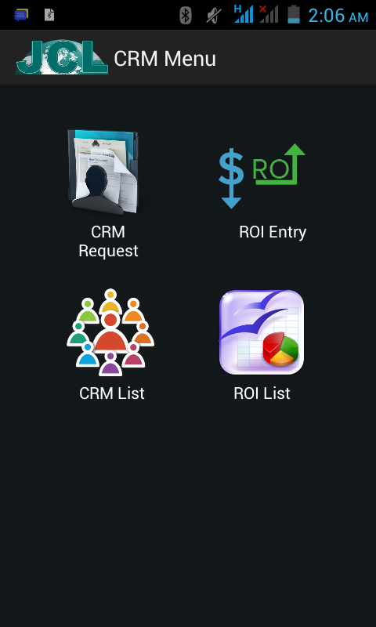
CRM Menu
When Click on CRM then these four submenu will list on next screen
CRM Request.
ROI Entry.
CRM List.
ROI List.

Slide 23
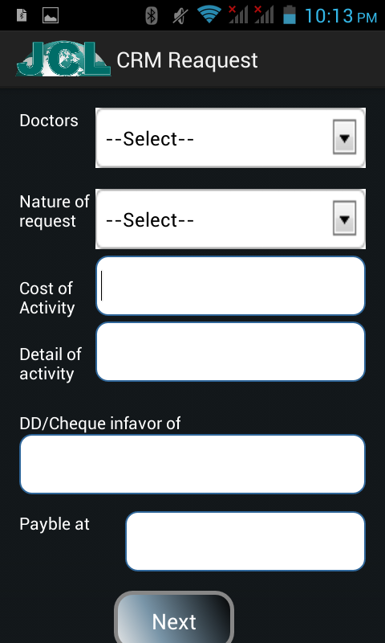
CRM Request
When Go for CRM then firstly have fill general information about CRM like Doctor , nature of request, cost of activity details about CRM and if payment will done by cheque or DD then details of it.
When this form will complete then go next for product page.

Slide 24
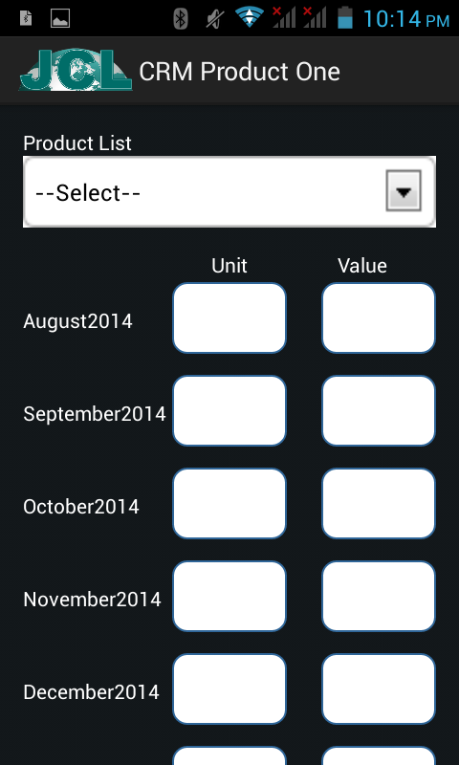
CRM Product
Here firstly chose the product from list and then fill the units every month. Fill units here and Value of that units will auto fill in other box.
The months will be 3 moth back and 6 month ahead.

Slide 25
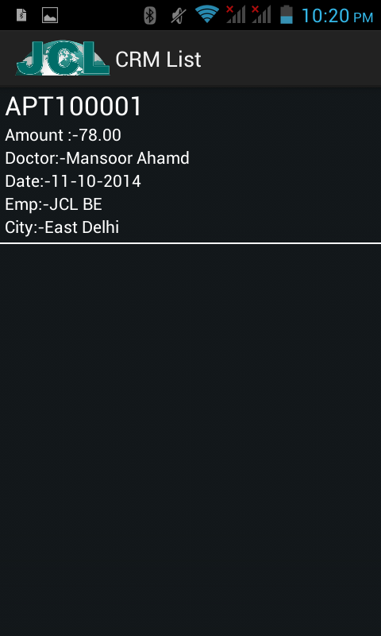
CRM List
When CRM will added then we can see that CRM in CRM list Menu.
Here we can see summery of the CRM like CRM number, Amount, Doctor etc.

Slide 26
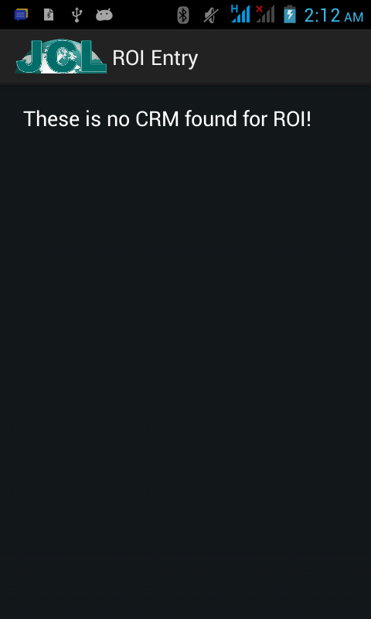
ROI Entry
When CRM will approved by different approval authority the that CRM will list here.
When CRM start listing here then click on record and it will take to next screen where you will entry for ROI for selected Products in CRM.

Slide 27
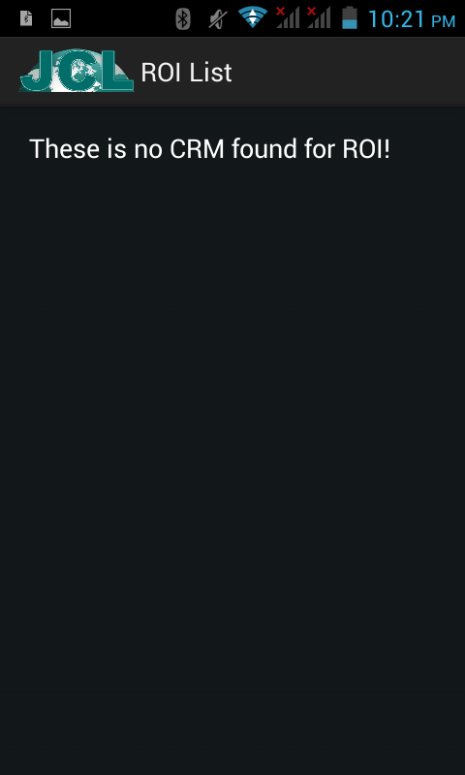
ROI List
When ROI data submit successfully from ROI Request Screen then that ROI will start listing here with ROI amounts.

Slide 28
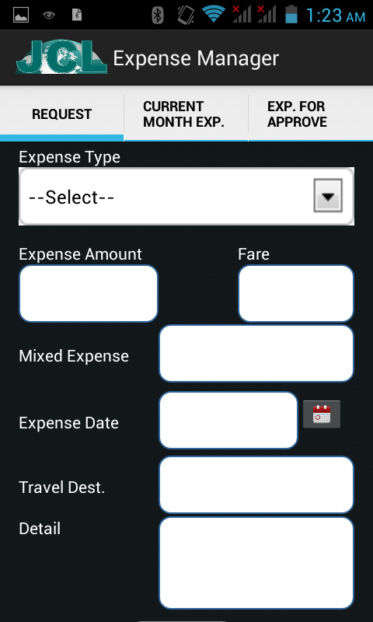
Expense Request
Here can request for Expense.
Chose the Expense type amount will auto fill, if fare is applicable then fare, Expense date, travel destination and Other details about expense. Submit the data, it expense request will be done.

Slide 29
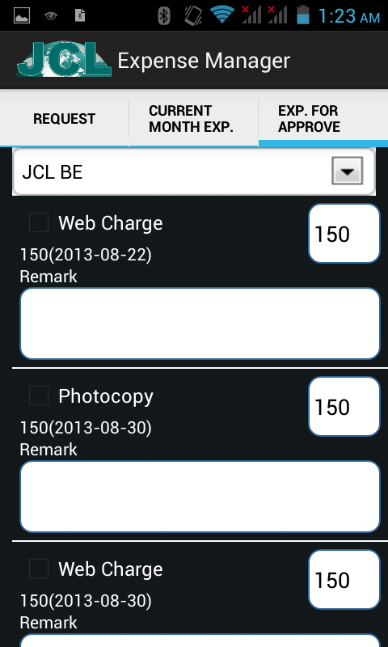
Expense For Approval
Expense for Approval Tab will display only for Approval authorities who can approve the expense.
Here Expense type, Amount with date display here, if want to change the amount just change it, write the remark and select check box and finally will submit this.

Slide 30
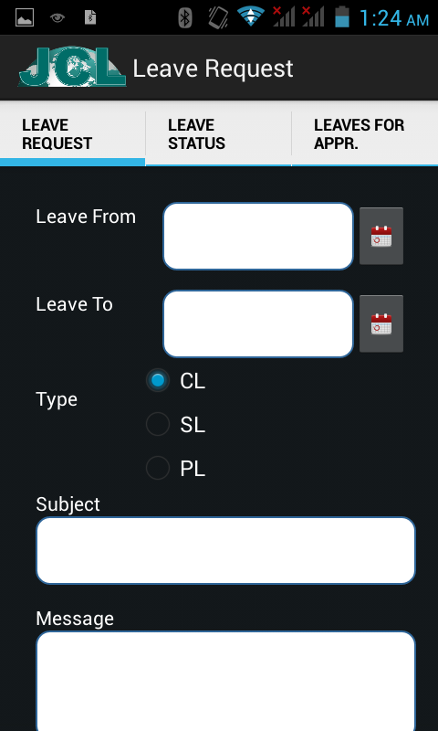
Leave Request
Leave Request Menu here we can request for leave.
Select from date of Leave and To date, after that chose leave type and fill subject and Message about request.
Submit the request leave will applied.

Slide 31
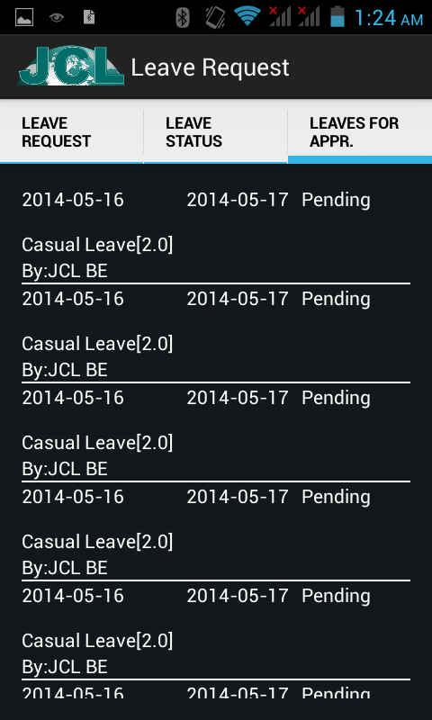
Leave For Approval
Leave For Approval tab only display for Approval Authorities.
List of Requested leave are showing, For approved or reject leave , click on record.

Slide 32
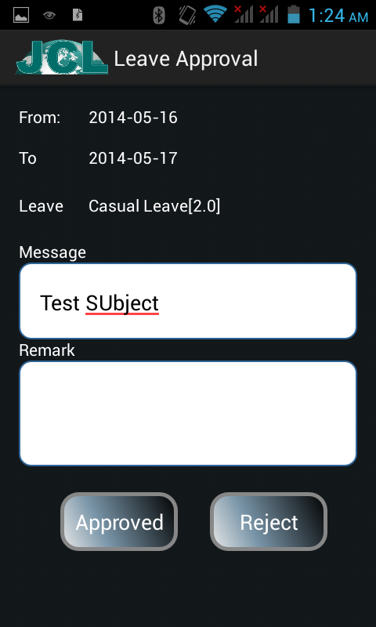
Approve/Reject Leave
When click on Record on Leave For Approve screen then that will comes on this screen here details of that leave will show.
After review the leave Authority can approve or reject that request with remark.

Slide 33
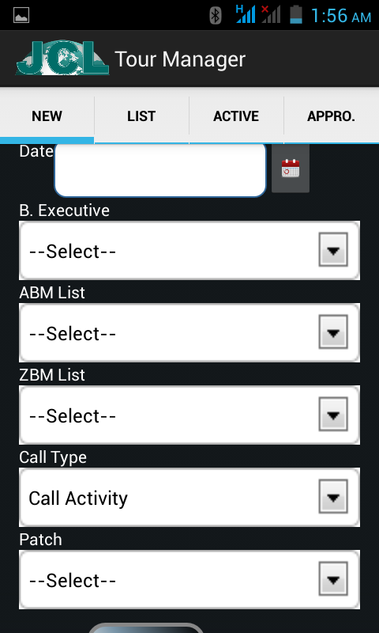
Tour Plan
In tour plan menu we can create tour plan for next month.
Select the date of Tour, work with details, type of activity like call or non call and patch.
Submit the record and then crate for next date or other plan.

Slide 34
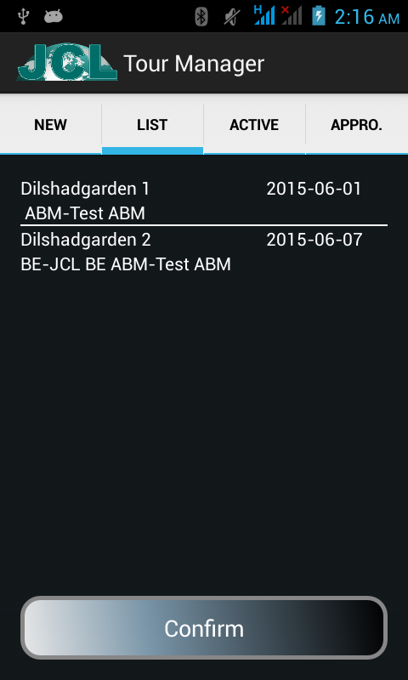
Confirm Tour Plan
All the Created Tour plan are listing here for Final confirmation. Firstly check the plan and if any plan wanted to change just by click and edit that record.
When all is checked then click confirm button this will send your TP to your reporting authority for Approval.

Slide 35
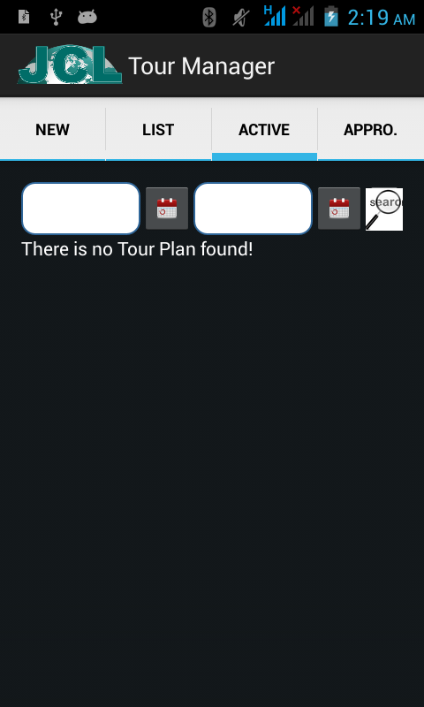
Active Tour Plan
The Approved TP for the current month.
So the tour plan on which we work on current month that TP will list here.

Slide 36
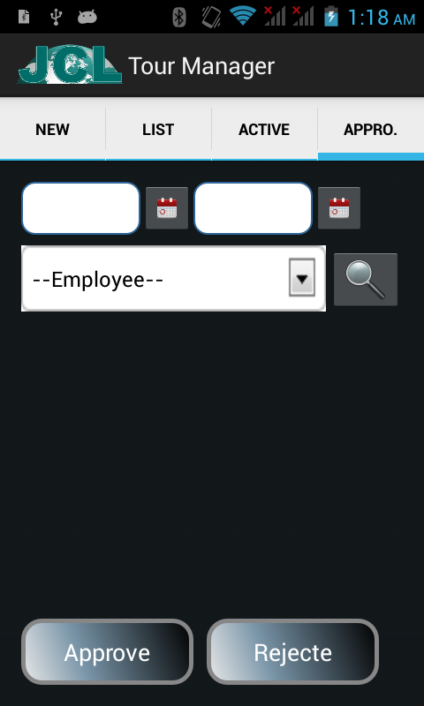
Approve Tour Plan
This Tab Only Display for Reporting authorities.
Here authority can check the TP of next month and also he can approve or Reject that TP from here.
Once the reject and Approve that TP then that will not changeable any more.

Slide 37
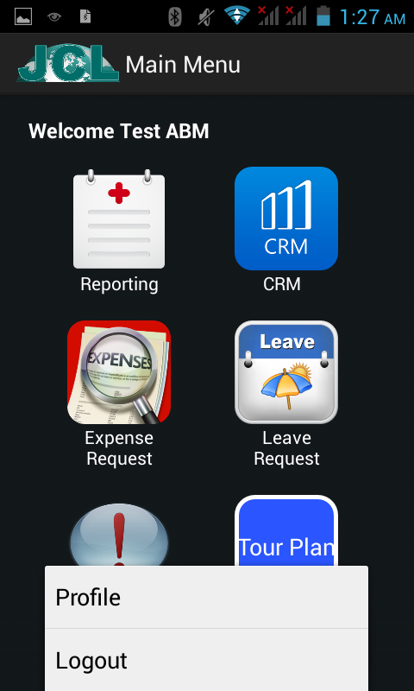
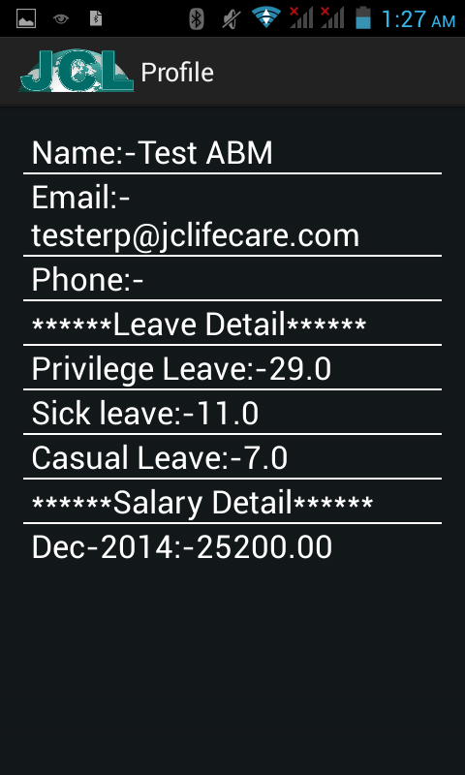
Profile Option
When we click on Menu Option on Welcome screen then we can see the two option one is for See the profile and another is logout
When click on profile it looks like second screen here.

Slide 38
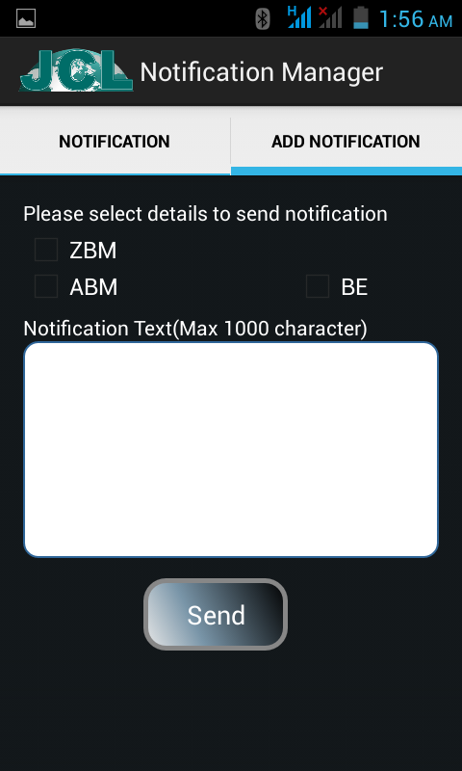
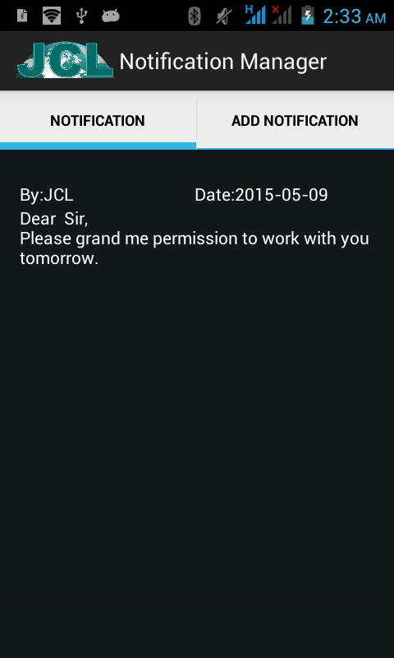
Notification
Add Notification to your reporting Authority or your team member, just like a sort SMS.
Also we can see the notification if some one sent you and tour plan alert etc.

Slide 39
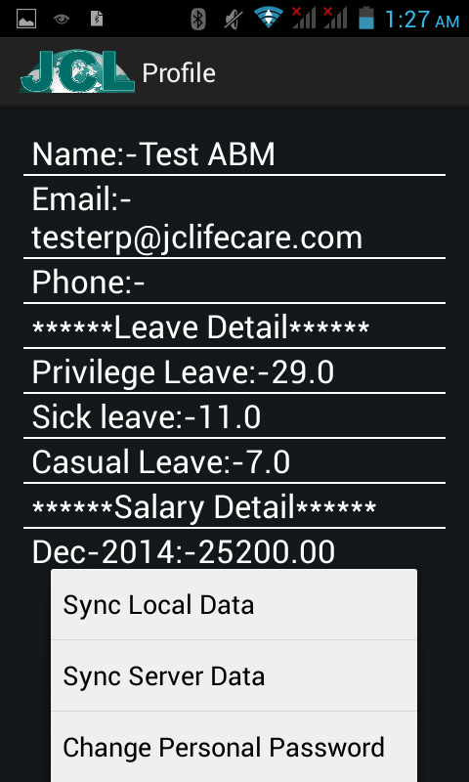
Sync Data from/to Server and More
On the Profile page again click on Menu option then we will see three more Option
Sync Local Data:- If you feel that your data did not sync to server then click here.
Sync Server Data:- If any data related to doctor, chemist or other s are missing on your app then sync server data.
Change Personal Password:- From here we can change the personal password which we have fill at the time of installation,

Slide 40
END
JC Lifecare

